Slide 1

AMRITA SCHOOL OF ARTIFICIAL INTELLIGENCE, BENGALURU
B. Tech in Artificial Intelligence and Data Science (AID)
Fourth Semester, Section F, Academic Year: 2024-25
END-TERM PROJECT on
SPEAKER IDENTIFICATION USING DEEP LEARNING TECHNIQUES
Presented by Group No. 06
B Nithin Kumar(BL.EN.U4AID23007)
T Sai Swaroop(BL.EN.U4AID23051)
V Dasa Manoj(BL.EN.U4AID23055)
P Sai (BL.EN.U4AID23063)
Mentor : Dr. Debanjali Bhattacharya

Slide 2

Contents
Introduction
Problem Statement
Dataset Description
Summary of SOTA
Methodology
Results
Future Works
Conclusion
Notes:
The idea behind our project is simple — we wanted to create a system that can make the entire placement process easier for everyone involved, whether it's the students, placement officers, or recruiters.
Using this system, students can register, upload their resumes, and apply for jobs. Placement officers can post job openings and recruiters can view student applications.
We used PHP for the backend logic and MySQL for storing data. This helps ensure that the system works dynamically and securely.

Slide 3
Introduction
Speaker identification ≠ speech recognition.
Crucial for security, personalization, access control.
Deep learning provides superior accuracy over traditional methods.
This project uses LibriSpeech and multiple models for robust results.
Deep Learning learns complex patterns automatically.
Notes:
The idea behind our project is simple — we wanted to create a system that can make the entire placement process easier for everyone involved, whether it's the students, placement officers, or recruiters.
Using this system, students can register, upload their resumes, and apply for jobs. Placement officers can post job openings and recruiters can view student applications.
We used PHP for the backend logic and MySQL for storing data. This helps ensure that the system works dynamically and securely.

Slide 4

Problem Statement
Every person has a unique voiceprint, shaped by vocal tract, pitch, accent, and speaking style.
Capturing this uniqueness accurately is non-trivial.
Voice-driven applications need to identify speakers accurately and instantly — even from short speech segments.
With rising reliance on voice–controlled devices and voice authentication, we need a robust identification system.
Notes:
the placement process is still done manually — which means it takes a lot of time and effort. There are many chances for errors, and sometimes it becomes hard to track which students are eligible for which jobs.
Also, when there is no single system to manage all this, students, placement officers, and companies face communication gaps.
Another issue is that it's hard to generate reports quickly when the data is not in one place.

Slide 5
Dataset description
Title : Speaker Recognition Dataset.
Dataset comprises speeches from five prominent leaders:
Benjamin Netanyahu
Jens Stoltenberg
Julia Gillard
Margaret Thatcher
Nelson Mandela
Each audio in the folder is a one-second 16000 sample rate PCM encoded.
Divided a complete speech into 1500 wav files.
A folder called background _noise contains audios that are not speeches.
Notes:
To design and build a centralized web-based platform for placements.
To let students and companies register themselves easily.
To allow placement officers to post jobs and manage interview schedules.
To help students view job openings and apply if they are eligible.
To generate real-time reports that can be used for tracking and decision-making.

Slide 6
Summary of sota
Year | Title | Dataset/Domain | Methods Used | Key Results | Challenges
2024 | Model of the Speaker Identification and Verification Subsystem | LibriSpeech | Pseudo-ensemble neural network, SincNet, Diarization | Enhanced authentication in virtual meetings | High computational cost, limited scalability
2024 | Enhancing Speaker Identification through Reverberation Modeling and Cancelable Techniques | Chinese Mandarin Corpus | ANN, MFCC, DWT, reverberation modeling with comb filters | Robust in noisy environments, privacy-preserving | Reverberation complexity, feature distortion trade-offs
2024 | Text-Independent Speaker Identification using ANN, RNN, and CNN | VoxCeleb1 | CNN, ANN, RNN, MFCC, PNCC, GFCC, PCA | 96.90% accuracy, efficient training | Data-intensive, computationally expensive
2025 | Speaker Verification Enhancement via Speaking Rate Dynamics | Persian Speechprints | MFCC, delta-delta, vowel formants, data augmentation | 75% accuracy with augmentation, improved generalization | Small dataset, limited cross-language transfer
Notes:
To design and build a centralized web-based platform for placements.
To let students and companies register themselves easily.
To allow placement officers to post jobs and manage interview schedules.
To help students view job openings and apply if they are eligible.
To generate real-time reports that can be used for tracking and decision-making.

Slide 7
Methodology
Dataset Preparation:
Dataset: Extracted from the 16000_pcm_speech dataset.
Sampling Rate: Audio resampled to 16,000 Hz for consistency.
Duration Trimming: Fixed audio length to 1 second for uniform feature extraction.
Speaker Limitation: Limited to a maximum of 5 speakers for focused analysis.

Slide 8
Methodology
.
2. Feature Extraction:
MFCC Calculation: Used the librosa library to extract 13-dimensional Mel-Frequency Cepstral Coefficients (MFCCs) for each audio sample.
Feature Averaging: Calculated the mean of MFCCs across time frames for compact representation.
3. Data Encoding and Splitting:
Label Encoding: Converted speaker IDs to numerical labels using LabelEncoder.
Train-Test Split: Stratified 70-30 split to ensure class balance.

Slide 9
Methodology
.
4. ML Models Implentation:
Implemented several ML models like SVM, Random Forest Classifier, XGBoost, KNN, Logistic Regression.
5.DL Models Implementation:
Converted the encoded labels to one hot format.
Split the input and one hot encoded into 80:20 ratio.
Applied model like ANN with early stop to monitor validation loss.
Applied 1D CNN with two convolution layers and two dense layers.

Slide 10
Methodology
.
6.MR-HTF Preprocessing Technique:
Used a novel preprocessing technique called Multi-Resolution Harmonic Temporal Feature Fusion , that combines harmonic structure analysis with temporal dynamics at multiple resolutions for speaker identification.
7. HA-RQNet Architecture:
A novel architecture designed for speaker identification with:
- Hierarchical feature processing
- Quantized bottleneck layers
- Progressive dimensionality reduction
- Prototype-based classification
Integrated the new preprocessing , model training, evaluation components and ploted
required metrics.

Slide 11
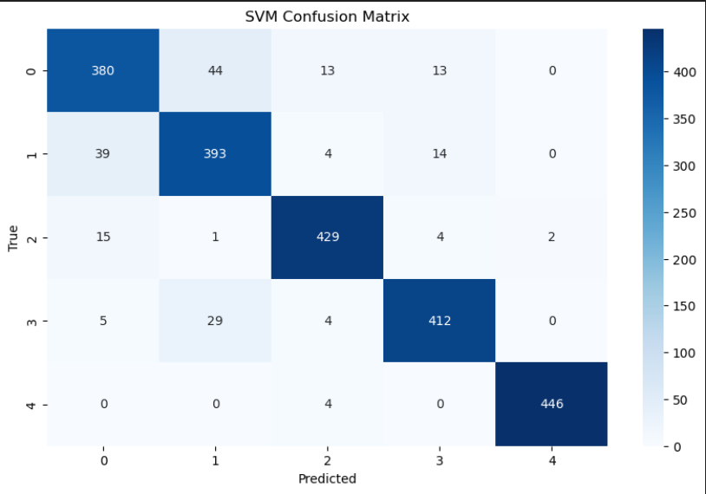
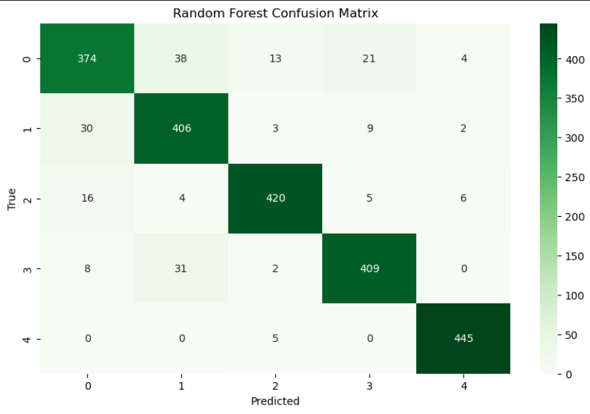
Results

Slide 12
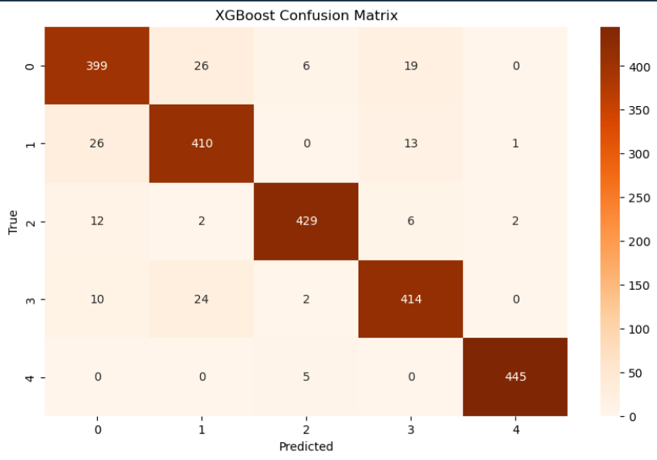
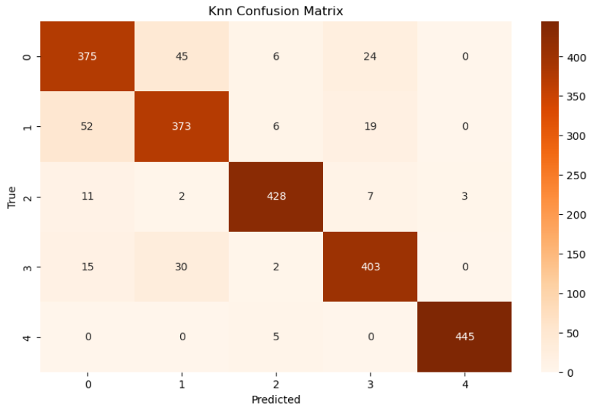
Results

Slide 13
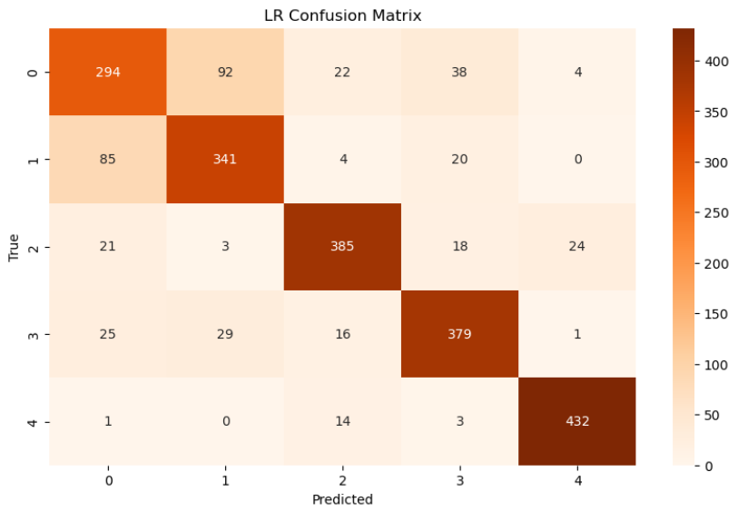
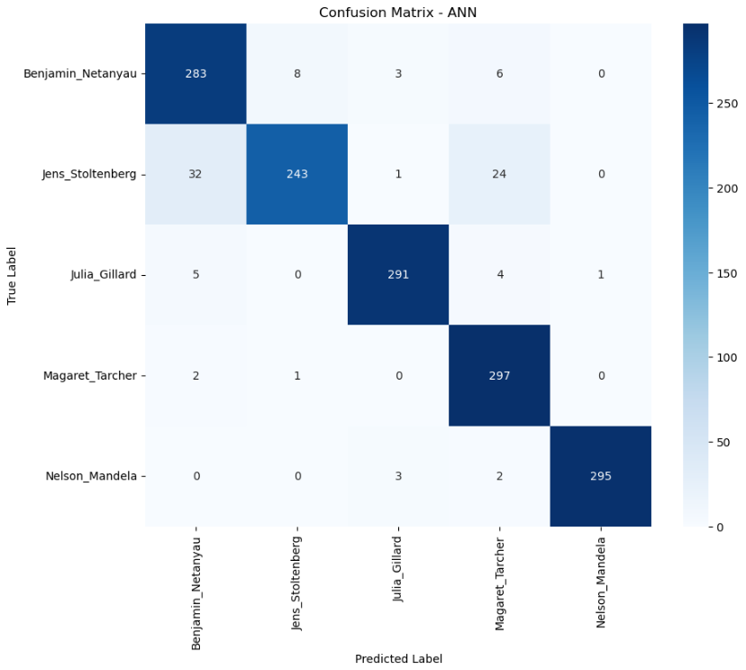
Results

Slide 14
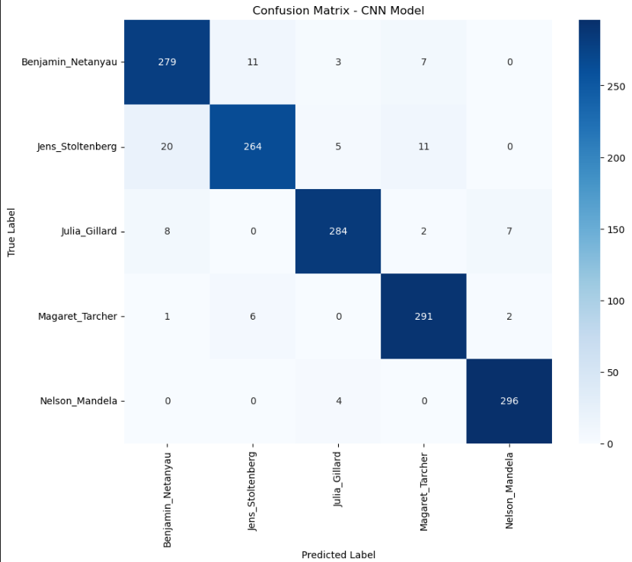
Results

Slide 15
Ablation table
MODEL | ACCURACY | 0 | 1 | F1-SCORE 2 | 3 | 4
SVM | 0.92 | 0.85 | 0.86 | 0.95 | 0.92 | 0.99
RFC | 0.91 | 0.85 | 0.87 | 0.94 | 0.91 | 0.98
XGB | 0.93 | 0.89 | 0.90 | 0.96 | 0.92 | 0.99
KNN | 0.90 | 0.83 | 0.83 | 0.95 | 0.89 | 0.99
LR | 0.81 | 0.67 | 0.75 | 0.86 | 0.83 | 0.95
ANN | 0.94 | 0.91 | 0.88 | 0.97 | 0.94 | 0.99
1D CNN | 0.94 | 0.92 | 0.91 | 0.95 | 0.95 | 0.98

Slide 16
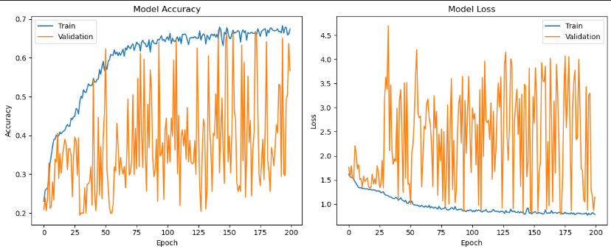
Results

Slide 17
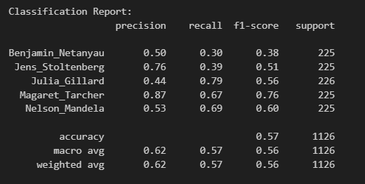
Results

Slide 18
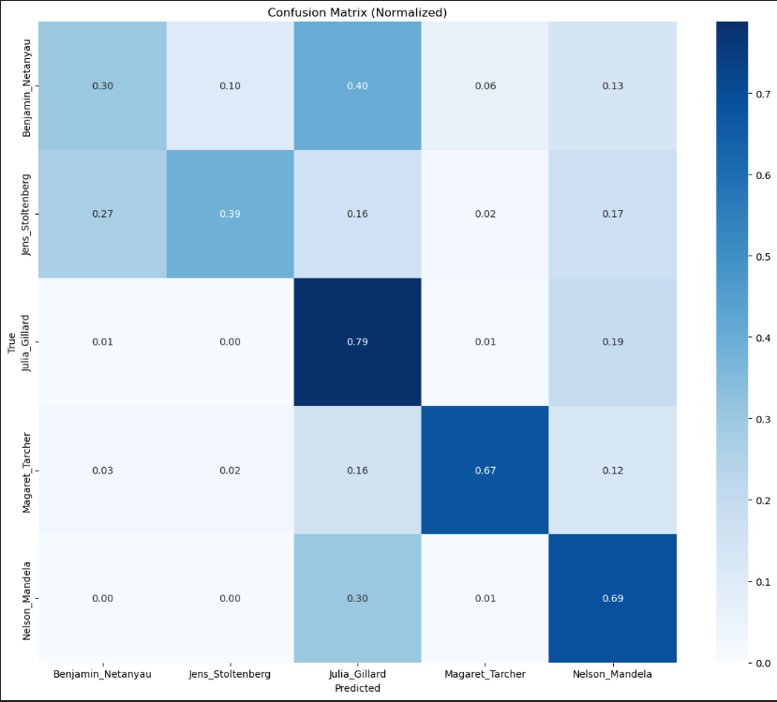
Results

Slide 19
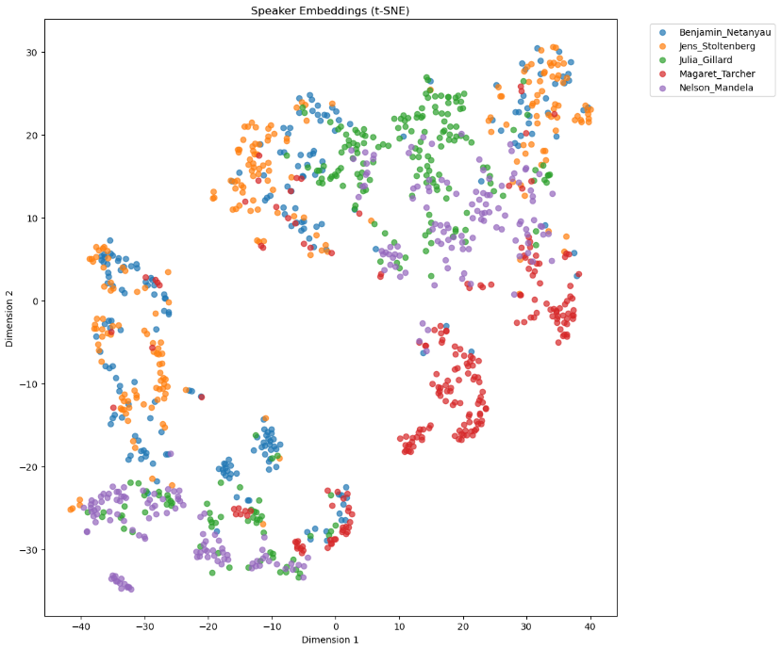
Results

Slide 20
Future Enhancements
Extend the model to handle hundreds or thousands of speaker identities.
Integrate CNNs, RNNs, Transformers, or x-vector-based models for better representation learning.
Train with noisy and overlapping speech to improve robustness in natural environments.
Deploy in voice authentication, smart assistants, or security systems.
Optimize the pipeline for low-latency, on-device inference.

Slide 21
Conclusion
Successfully built a speaker identification system using MFCC features and deep learning.
Demonstrated that short-duration speech (1 sec) can carry sufficient speaker-specific information.
Achieved high accuracy with a simple neural pipeline on a limited speaker set.
Validated the importance of preprocessing and feature extraction in voice-based biometrics.

Slide 22
References
Developed a text-independent speaker ID system using MFCC, PNCC, and GFCC features. Achieved 96.9% accuracy on VoxCeleb1 but required high computational resources.
Focused on speaking rate dynamics using vowel formants and augmented MFCC-based features. Achieved 75% accuracy. However, generalization beyond Persian speakers was limited due to dataset constraints.
Improved performance on short utterances using in-domain and out-of-domain augmentation along with vocal-tract normalization. Reported a 50.15% improvement in EER but struggled with limited child speech data.
Used pseudo-ensemble models with speaker diarization on LibriSpeech for better speaker identification in virtual conference systems. Noted for high accuracy but computationally expensive.
Applied ANNs with MFCCs, DWT, and comb filters on Mandarin speech to handle reverberation. Demonstrated robust identification but faced complexity in balancing reverberation effects and feature distortion.

